Slide 1
Tech Interview Prep:
Tool Use Mechanics, Function Calling Protocols & The Client-Model Interaction Loop
“How does an LLM know when and how to call an external tool? Describe the client-model interaction loop during function calling.”
Slide 1: Title & The Architectural Illusion
Name: Dara Sen
Class: AD331 (Artificial Intelligence)

Slide 2
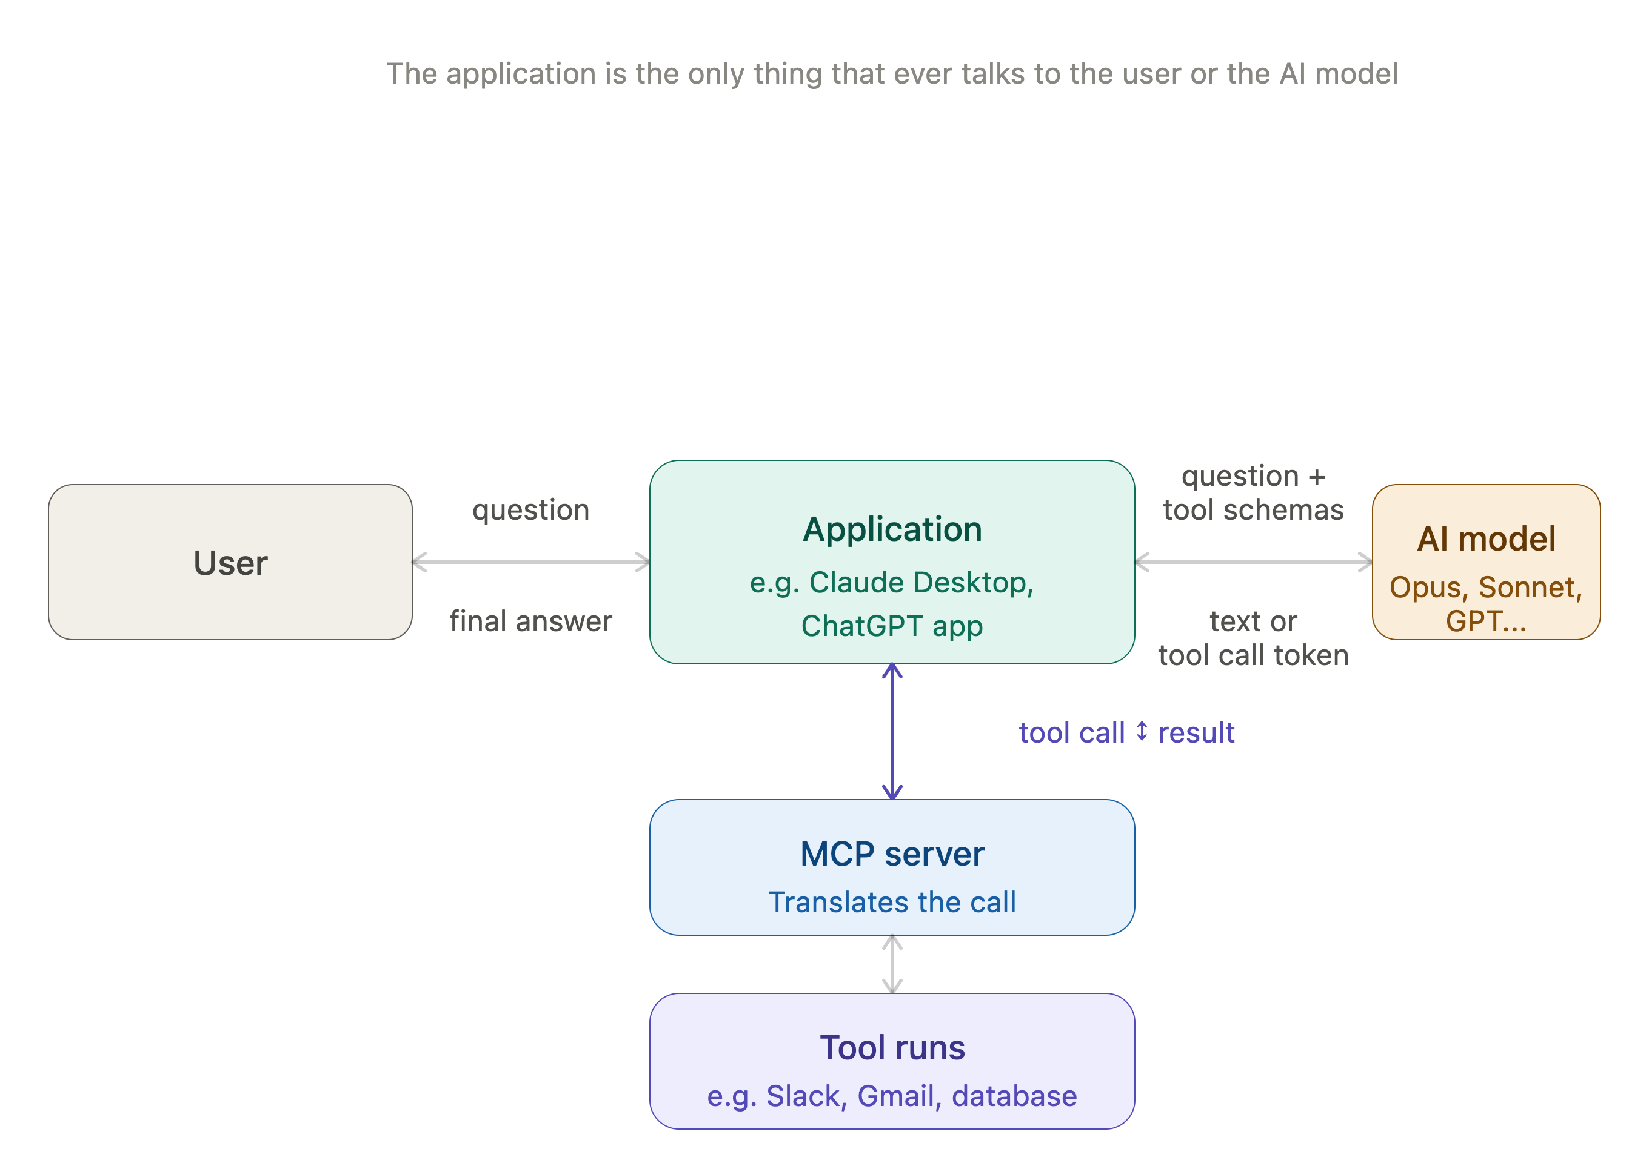
Slide 2: The “When”: Intent Detection & Tool Selection Mechanics

Slide 3
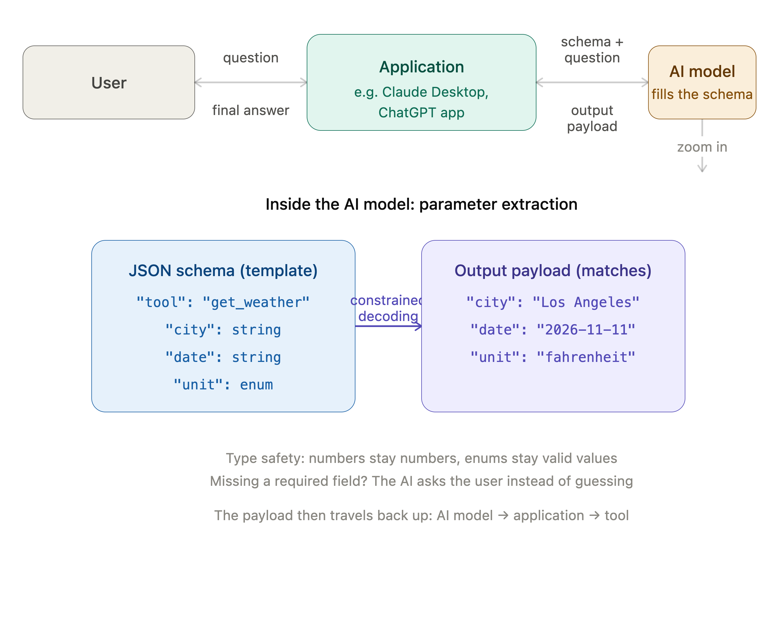
Slide 3: The “How”: Argument Generation & Schema Conformance

Slide 4
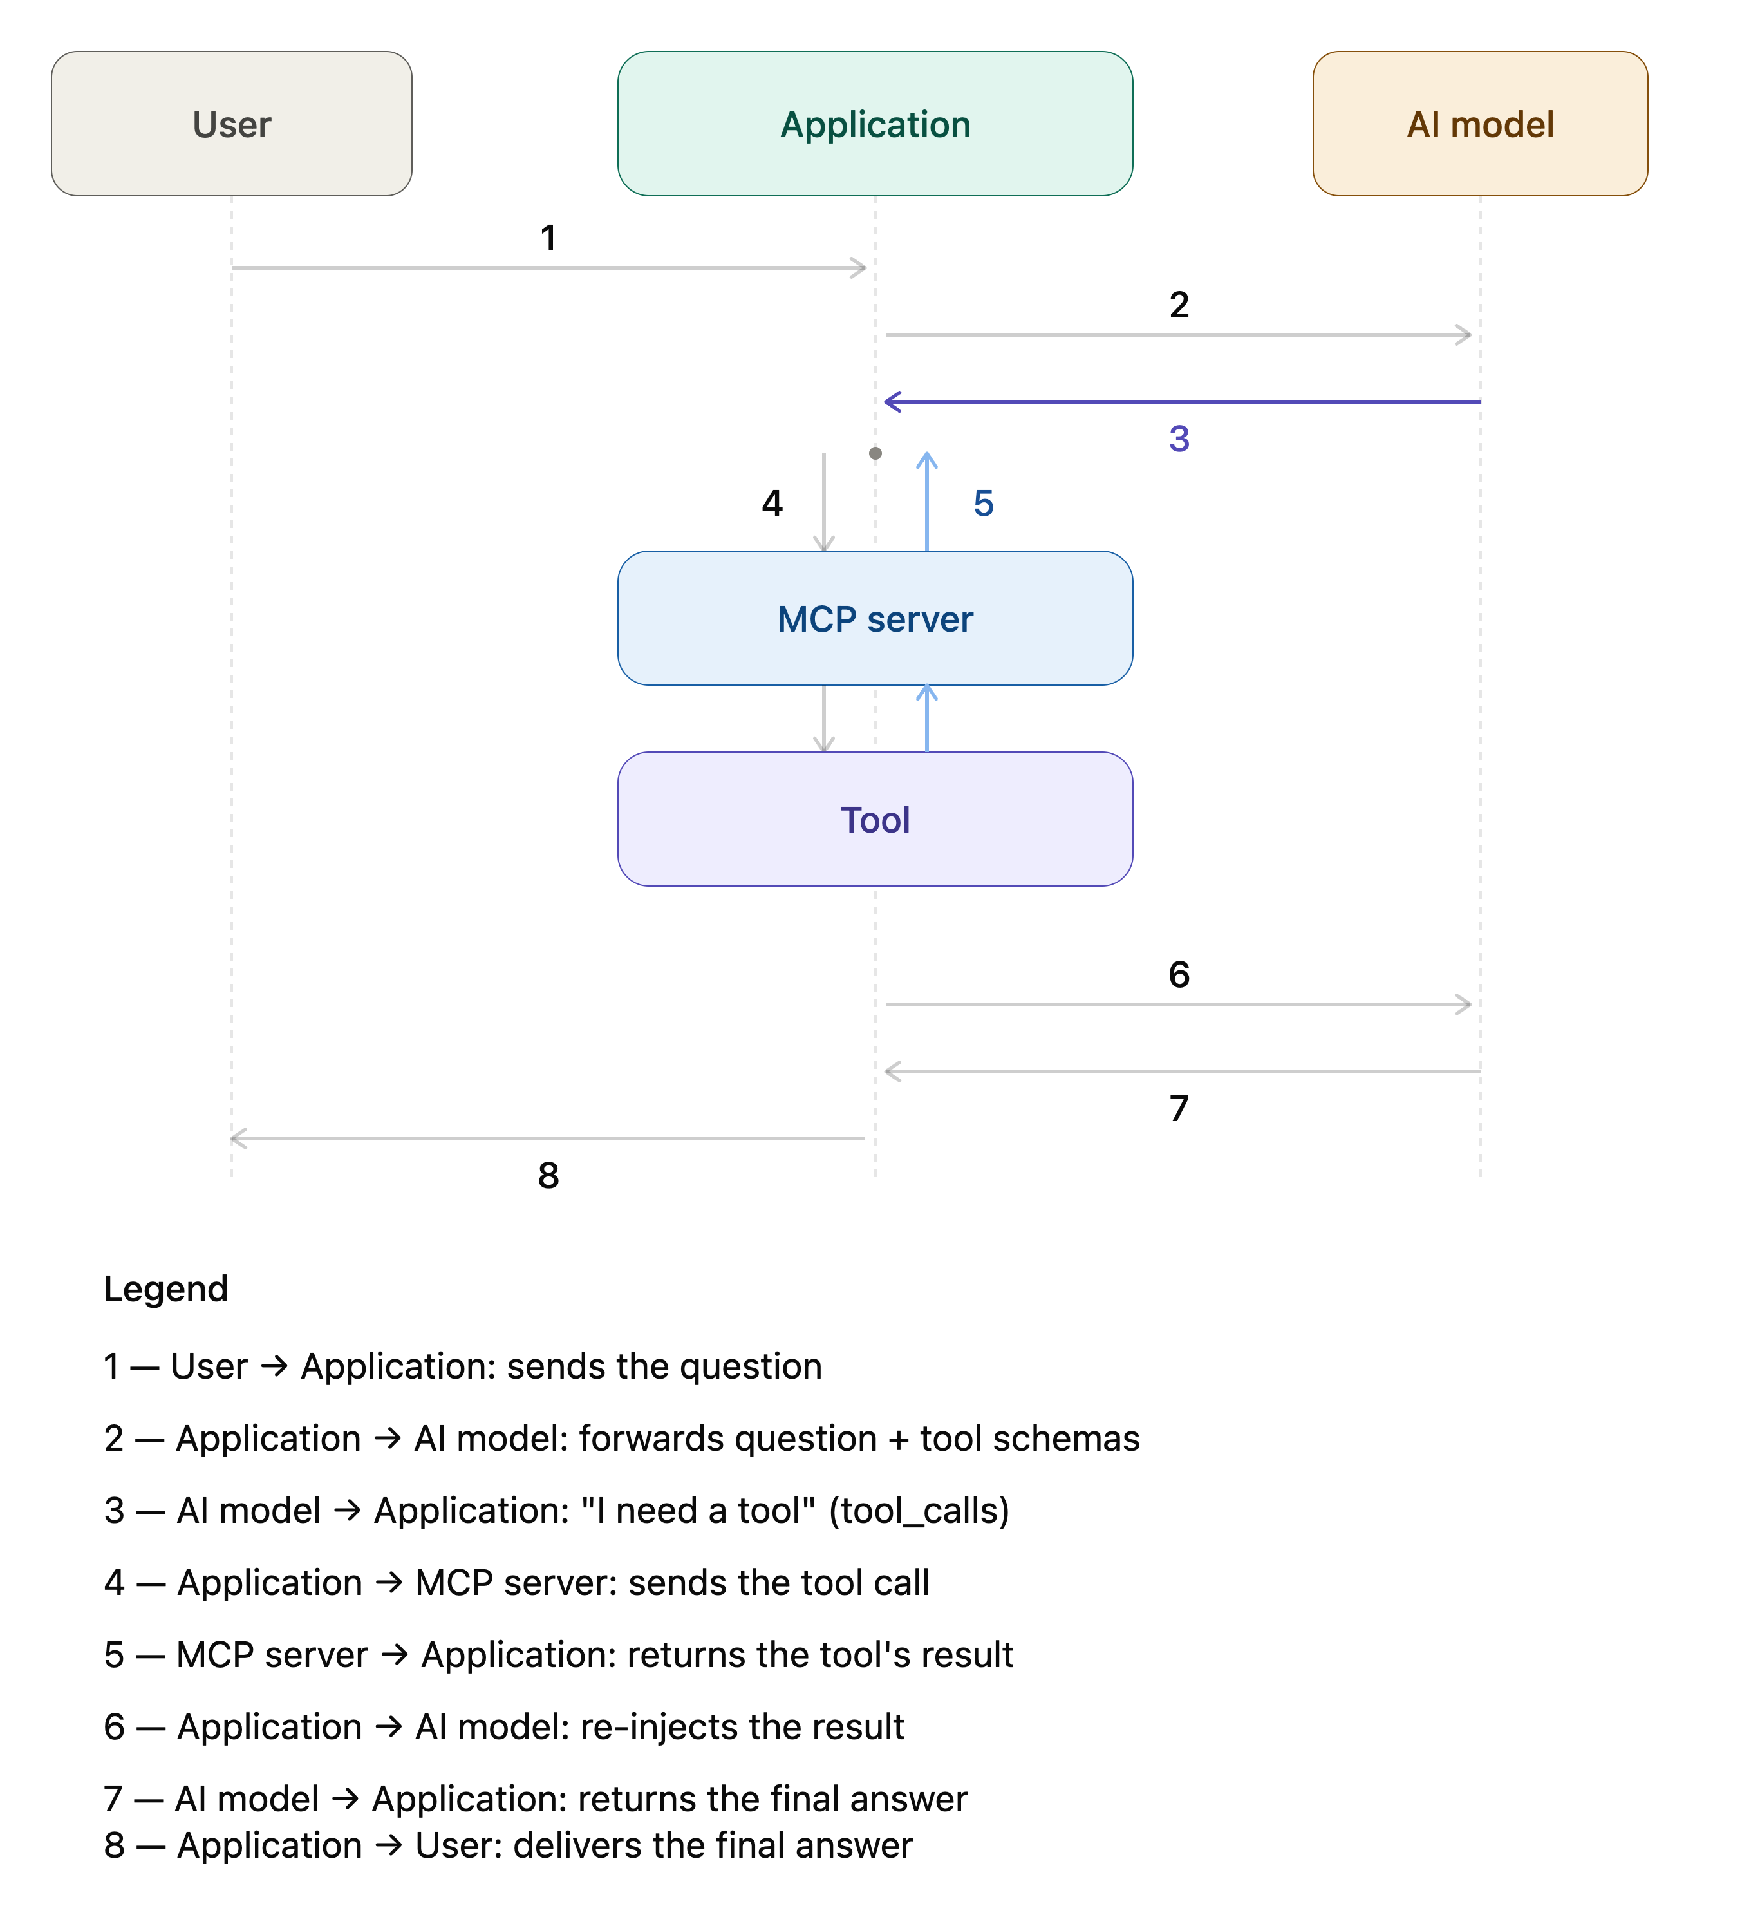
Slide 4: The Client-Model Interaction Loop: End-To-End Walkthrough

Slide 5
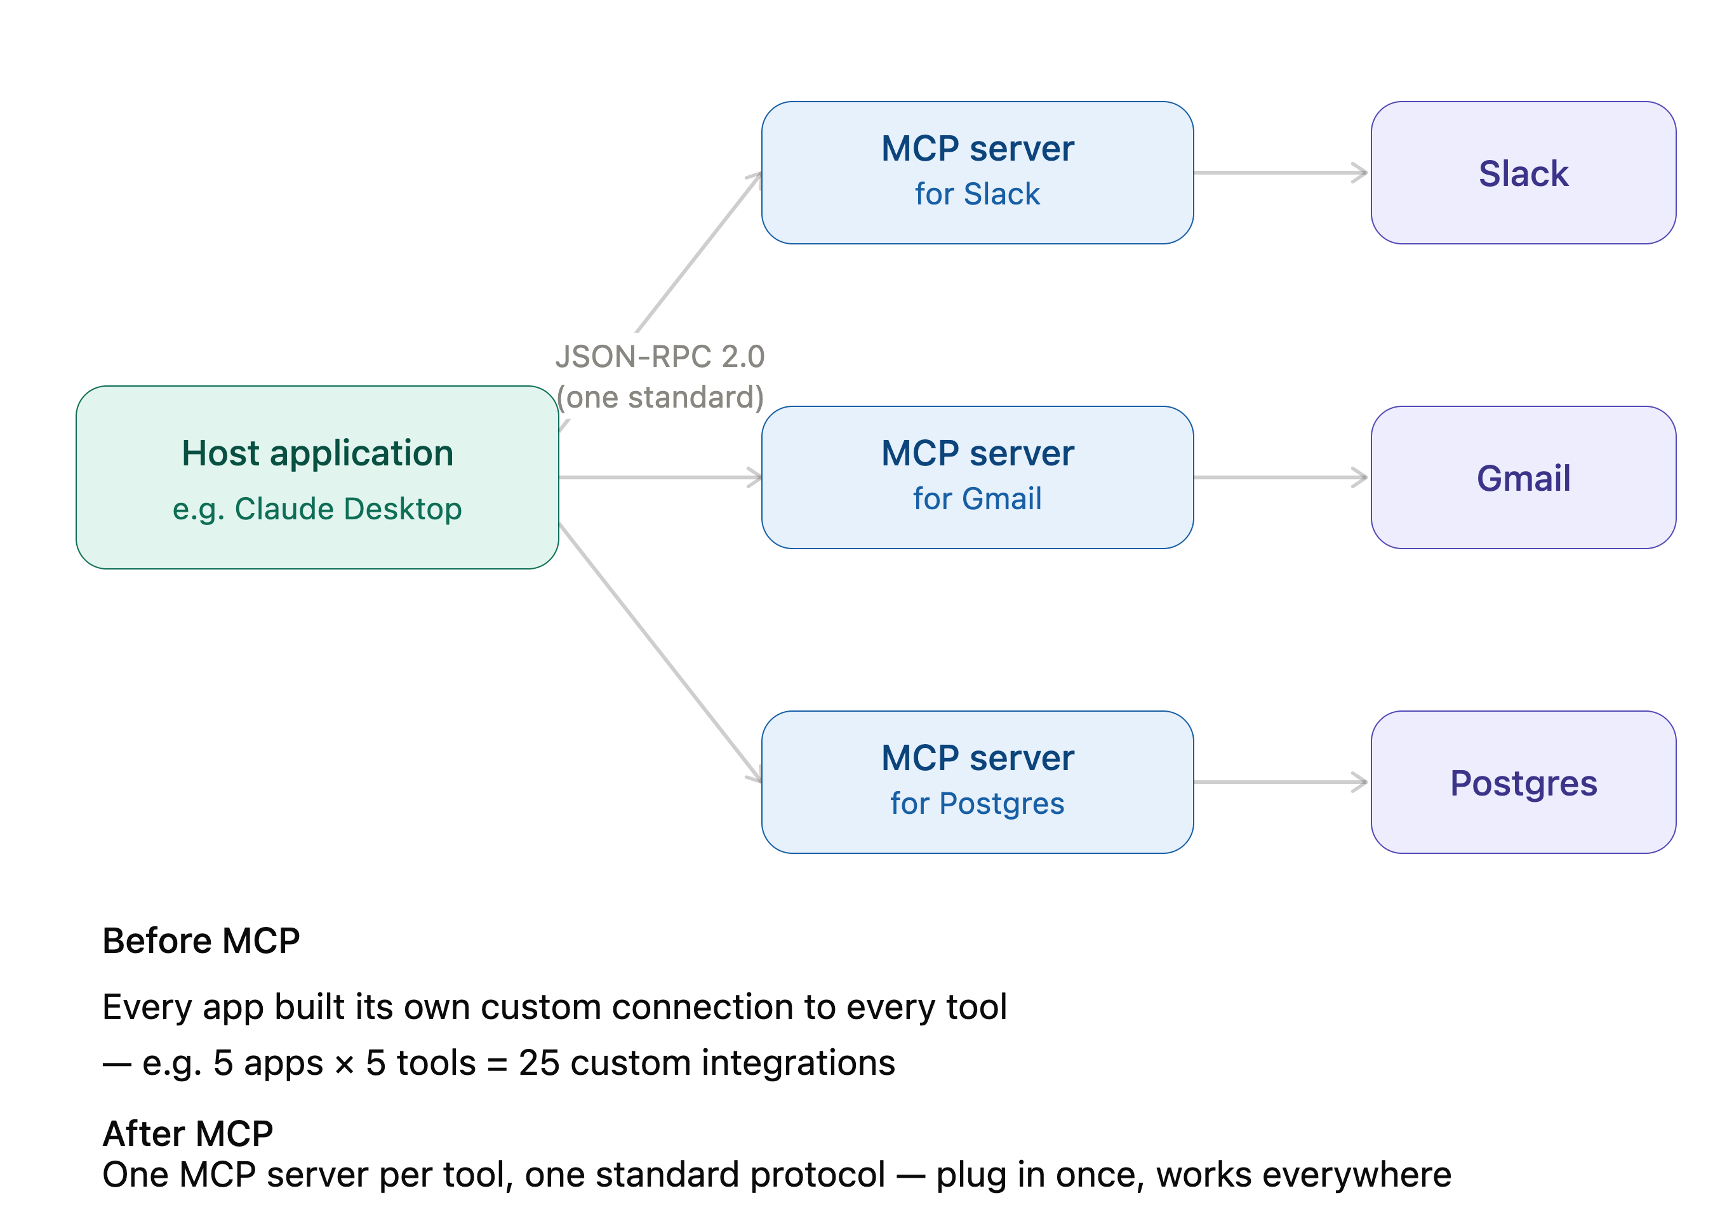
Slide 5: Standardizing Tool Protocols: Model Context Protocol (MCP)

Slide 6
Summary & Systems Engineering Takeaways
AI model vs. Application (Host) ➔ Orchestrator vs. Executor
Applicaton acts as validator (AI model’s output payload to be verified against JSON Schema)
JSON RPC 2.0 (one standard protocol)

